Slide 1
DECODE GAMING BEHAVIOUR USING SQL
Mentorness Internship Project
Name - J S N Gayatri Devi Megham
Batch – MIP-DA-06

Slide 2
Content
About the Project
Problem Statement
Objective
Dataset Description
Analysis using SQL

Slide 3
About the Project
This internship project is about to Decode Gaming Behaviour.
This dataset includes two tables:
Level Details Table:
`P_ID`: Player ID
`Dev_ID`: Device ID
`start_time`: Start Time
`stages_crossed`: Stages Crossed
`level`: Game Level
`difficulty`: Difficulty Level
`kill_count`: Kill Count
`headshots_count`: Headshots Count
`score`: Player Score
`lives_earned`: Extra Lives Earned
Player Details Table:
`P_ID`: Player ID
`PName`: Player Name
`L1_status`: Level 1 Status `
L2_status`: Level 2 Status
`L1_code`: Systemgenerated Level 1 Code
`L2_code`: Systemgenerated Level 2 Code

Slide 4
Problem Statement: In a virtual gaming environment, player performance analysis is crucial for game developers to enhance gameplay experiences and engagement. Your task is to analyze a dataset containing player details and level interactions to derive actionable insights. The dataset includes player information such as unique identifiers, names, and level statuses, along with detailed level interactions including start time, stage progression, performance metrics, and extra lives earned.
Objective:
Explore player performance trends and patterns across different game levels and difficulty settings.
Identify factors influencing player engagement and progression within the gaming environment.
Analyze the impact of player actions, such as kill count, headshots count, and extra lives earned, on overall gameplay performance.
Provide recommendations for game developers to optimize game design, difficulty levels, and player engagement strategies based on the analysis.

Slide 5
Dataset Description
Unique identifiers are assigned to each player.
Player names and their corresponding IDs are recorded.
The dataset tracks the status of players in both Level 1 and Level 2.
System-generated codes are provided for each level, likely for internal reference.
Player interactions, including gameplay details, are logged.
Each entry is associated with a specific player, level, and device.
Gameplay details include start time, stage progression, game level, and difficulty.
Player performance metrics such as kill count, headshots count, and score are captured.
The dataset also records the number of extra lives earned by players during gameplay.

Slide 6
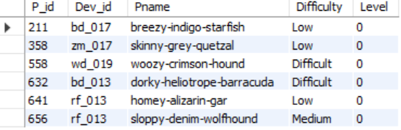

Analysis Using SQL
Extract `P_ID`, `Dev_ID`, `PName`, and `Difficulty_level` of all players at Level 0.
Output

Slide 7
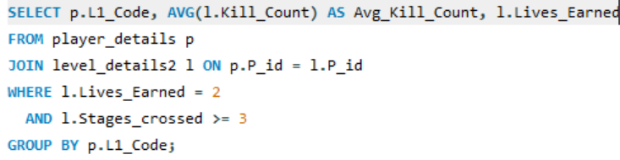

2) Find `Level1_code`wise average `Kill_Count` where `lives_earned` is 2, and at least 3 stages are crossed.
Output

Slide 8
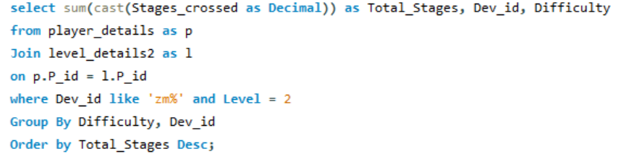
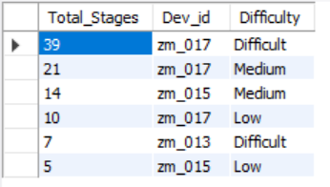
3) Find the total number of stages crossed at each difficulty level for Level 2 with players using `zm_series` devices. Arrange the result in decreasing order of the total number of stages crossed.
Output

Slide 9
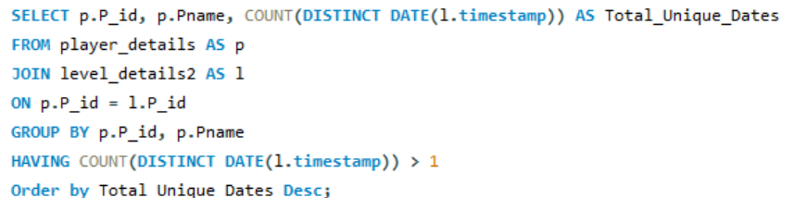
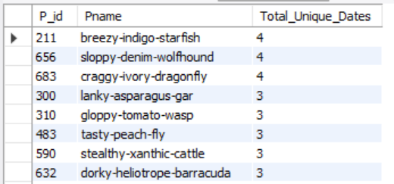
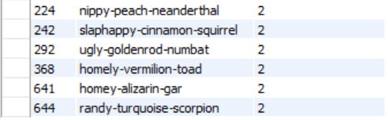
4) Extract `P_ID` and the total number of unique dates for those players who have played games on multiple days.
Output

Slide 10
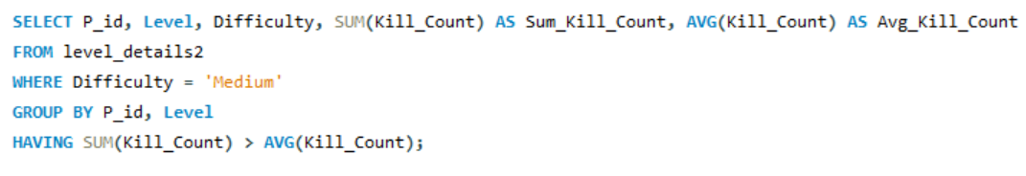
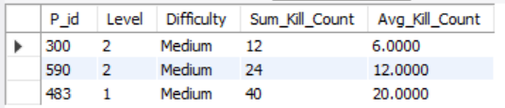
5) Find `P_ID` and level wise sum of `kill_counts` where `kill_count` is greater than the average kill count for Medium difficulty.
Output

Slide 11
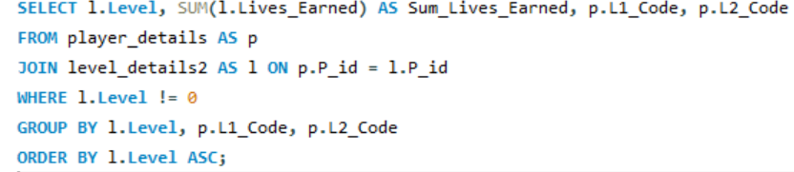
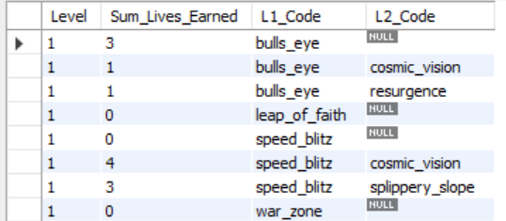
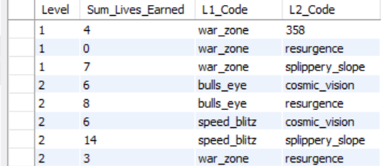
6) Find `Level` and its corresponding `Level_code` wise sum of lives earned, excluding Level0. Arrange in ascending order of level.
Output

Slide 12
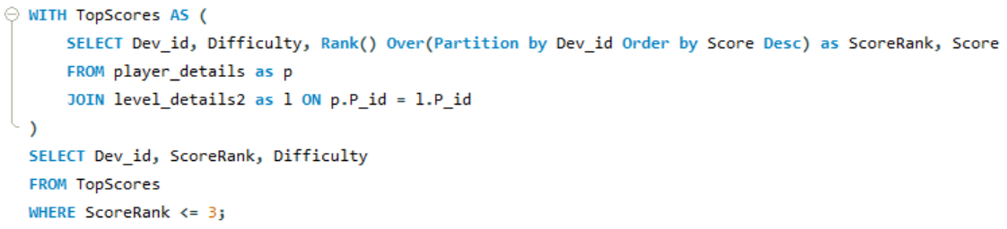
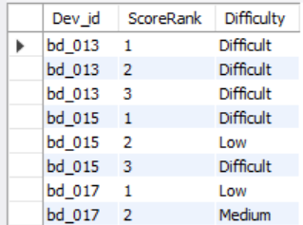
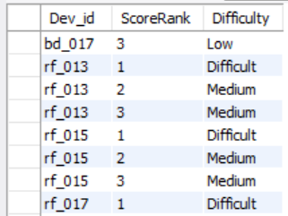
7) Find the top 3 scores based on each `Dev_ID` and rank them in increasing order using `Row_Number`. Display the difficulty as well.
Output

Slide 13
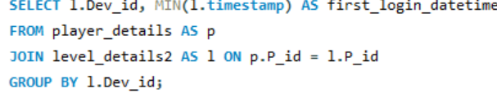
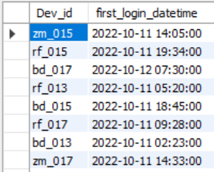

8) Find the `first_login` datetime for each device ID.
Output

Slide 14
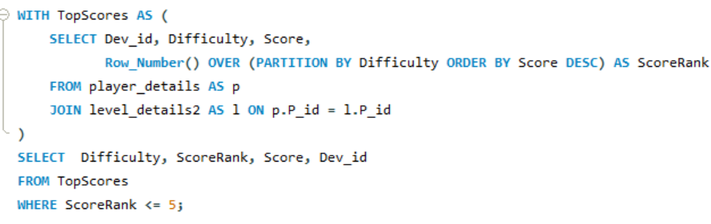
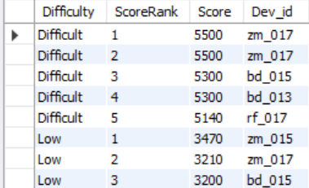
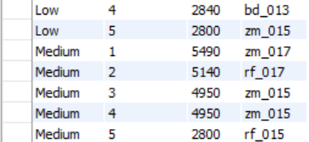
9) Find the top 5 scores based on each difficulty level and rank them in increasing order using `Rank`. Display `Dev_ID` as well.
Output

Slide 15
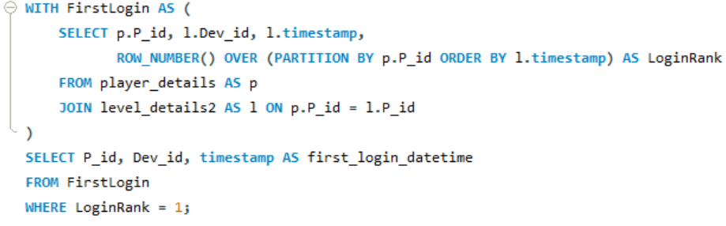
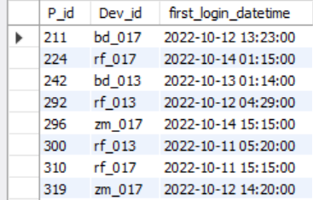
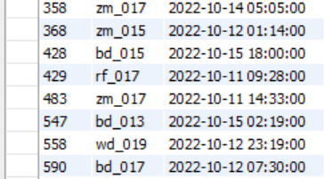
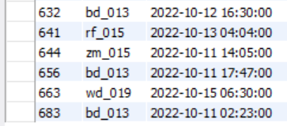
10) Find the device ID that is first logged in (based on `start_datetime`) for each player (`P_ID`). Output should contain player ID, device ID, and first login datetime.
Output

Slide 16
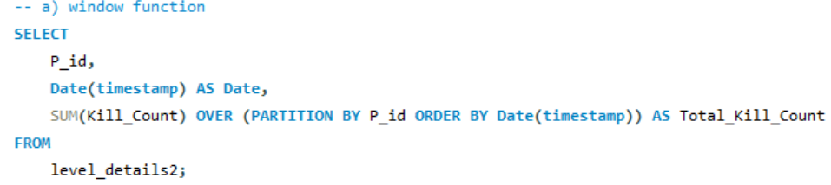
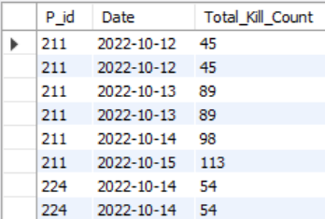
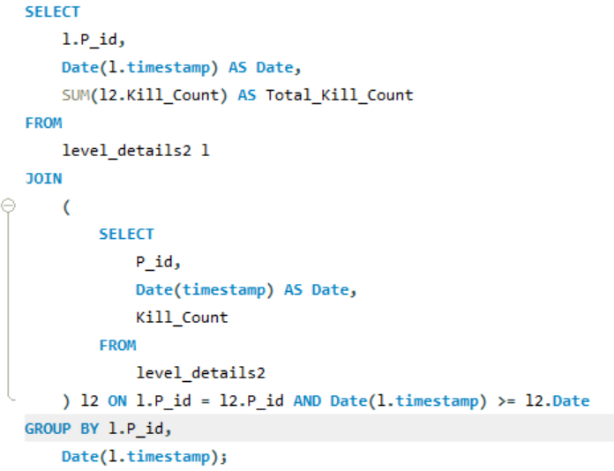
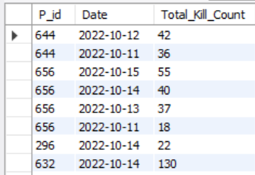
11) For each player and date, determine how many `kill_counts` were played by the player so far. a) Using window functions b) Without window functions
a)
b)
Output

Slide 17
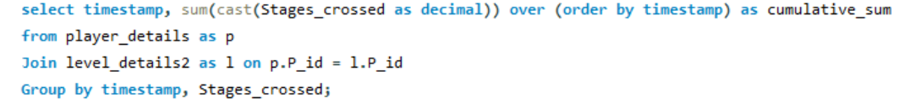
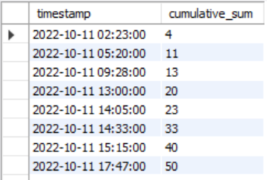
12) Find the cumulative sum of stages crossed over `start_datetime` for each `P_ID`, excluding the most recent `start_datetime`.
Output

Slide 18
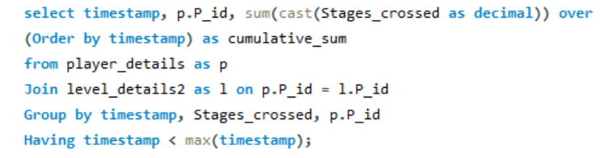
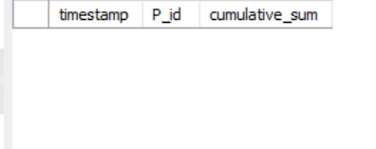
13) Extract the top 3 highest sums of scores for each `Dev_ID` and the corresponding `P_ID`.
No Data is Returned.
Output

Slide 19
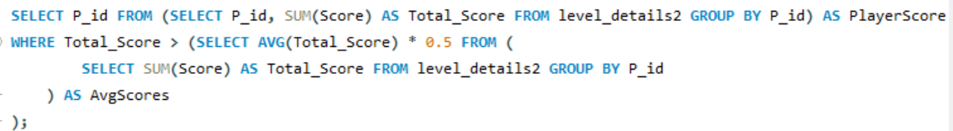
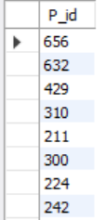
14) Find players who scored more than 50% of the average score, scored by the sum of scores for each `P_ID`.
Output

Slide 20
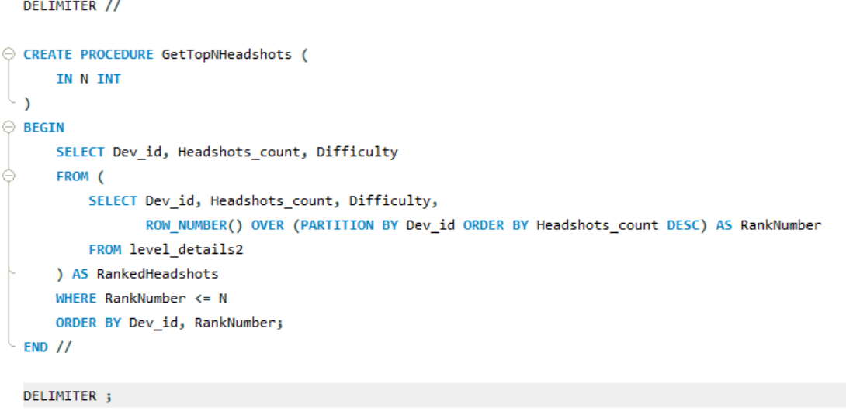
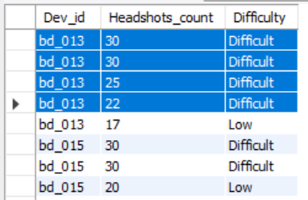

15) Create a stored procedure to find the top `n` `headshots_count` based on each `Dev_ID` and rank them in increasing order using `Row_Number`. Display the difficulty as well.
Output

Slide 21
Thank You

